Slide 1
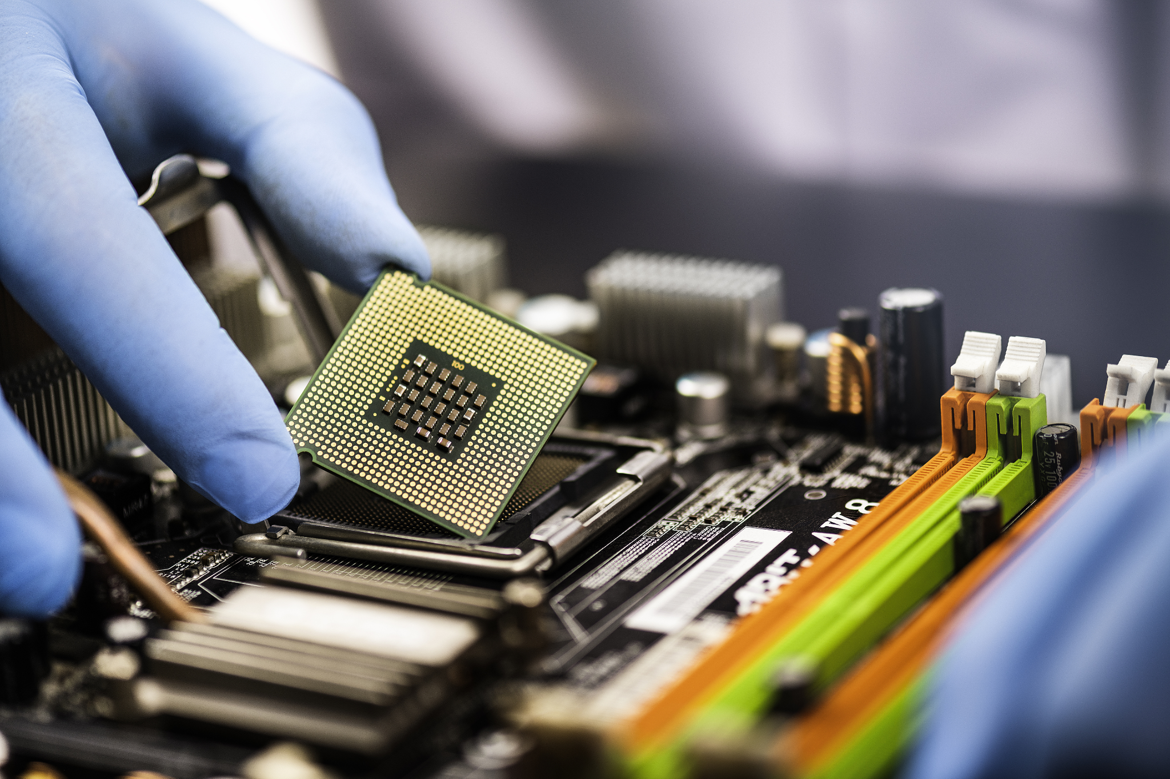

FinFET
Anirudh Santhosh (20BAC10003)
Yashraj Karwa (20BAC10009)
Varun Ram S (20BAC10038)

Slide 2
Index
1
5
Symbol
Introduction
6
2
History
Graph
3
Working
7
Pros and Cons
4
Types
8
Application

Slide 3
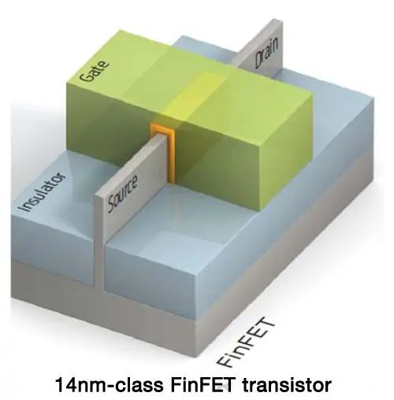
Introduction
A FinFET is classified as a type of multi-gate Metal Oxide Semiconductor Field Effect Transistor (MOSFET).
The gate of the FinFet is wrapped around (a wrap-around gate) which reduces leakage current thereby increasing effectiveness.

Slide 4
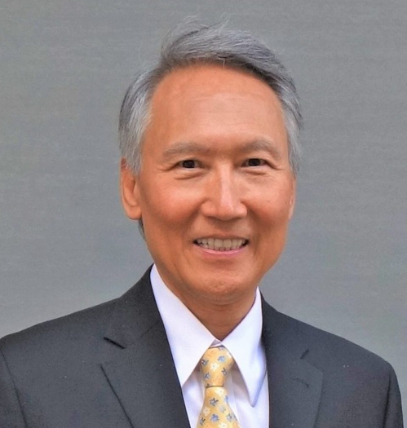
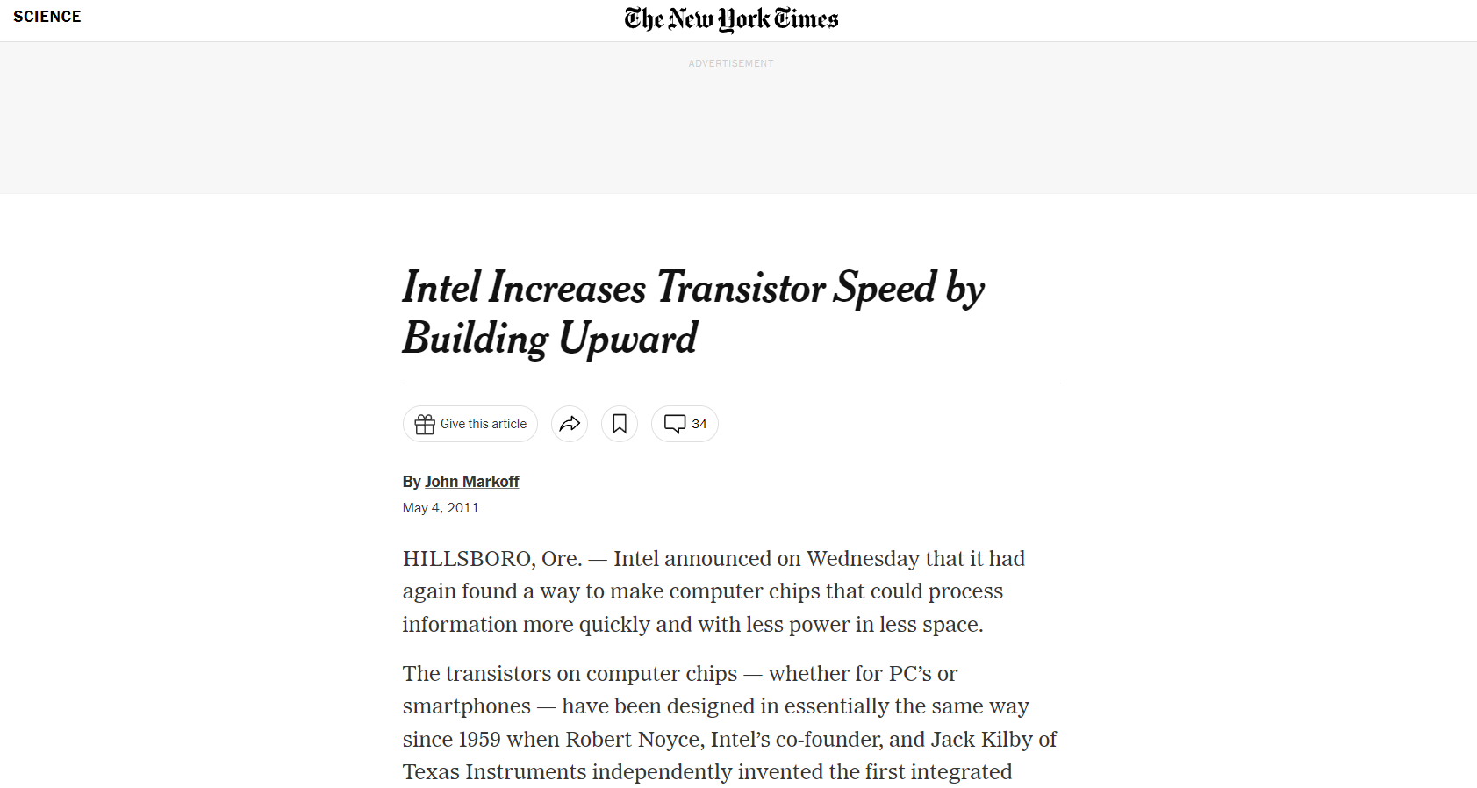
History
It was first developed at the University of Berkley, California by Chenming Hu and his colleagues.
He was working on overcoming the short channel effects

Slide 5
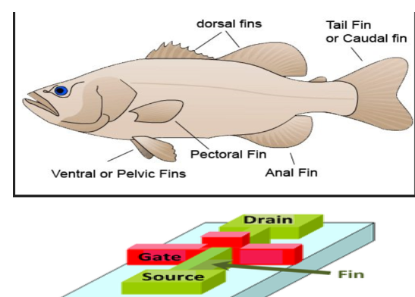
Significance behind the name
.

Slide 6
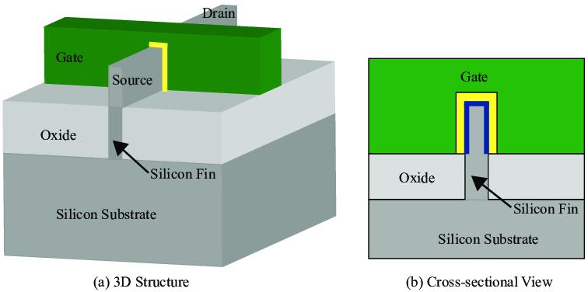
3D Structure and Cross-Sectional View
.

Slide 7
Main goal in FinFET
Our aim is to make the transistors as small as possible.
Scaling down more reduces the ability of gate to control the flow of current in the channel.
This is what we call the short channel effect.(When the channel length is of same order as the depletion layer width of source and drain then no resistance hence gate cannot control)
Shrinking the gate length (Lg) below 90 nm produces a significant leakage current, and below 28 nm, the leakage is excessive, rendering the transistor useless.
As we have more gates hence no leakage current.

Slide 8
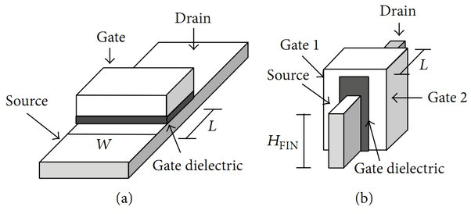
Finfet working
Planar
Vertical

Slide 9
Traditional working vs Finfet
Channel only on the surface
As the channel decreases control over the device is reduced
Leakage is present more.
Channel over the 3 surfaces
More control due to more gates
Less leakage

Slide 10
Types of Finfet
Based on basis of gate design:
Double gate
Tri-gate

Slide 11
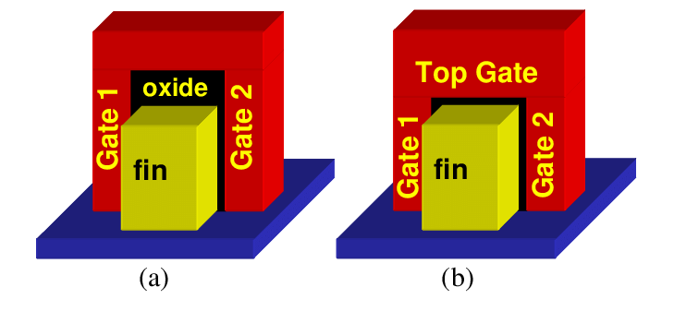
Double gate vs Triple gate

Slide 12
Types of Finfet
Based on number of gates:
Shorted gate
Independent gate

Slide 13
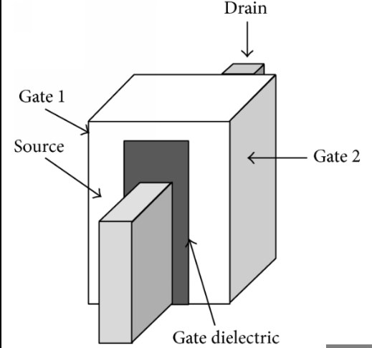
Short gated Finfet
SG FinFET’s are 3 terminal device.
Both the Gate 1 and Gate 2 (front and back gate) are shorted together.
The channel formed is controlled by both the gates.

Slide 14
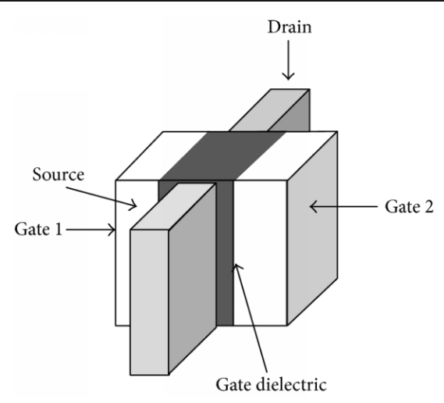
Independent gated Finfet
IG FinFET’s are 4 terminal device.
Both the Gate 1 and Gate 2 (front and back gate) are physically independent.
As the gates are different voltages can be applied making it more flexible.

Slide 15
2) Based on basis of substrates
Bulk finfet
SOI finfet

Slide 16
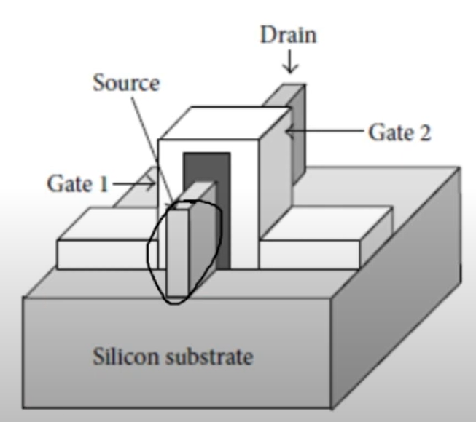
Bulk Finfet
Fabrication is easy as fewer fabrication steps and cost is less.
Difficult to control the performance as channel may have impurities.
Device isolation is required.

Slide 17
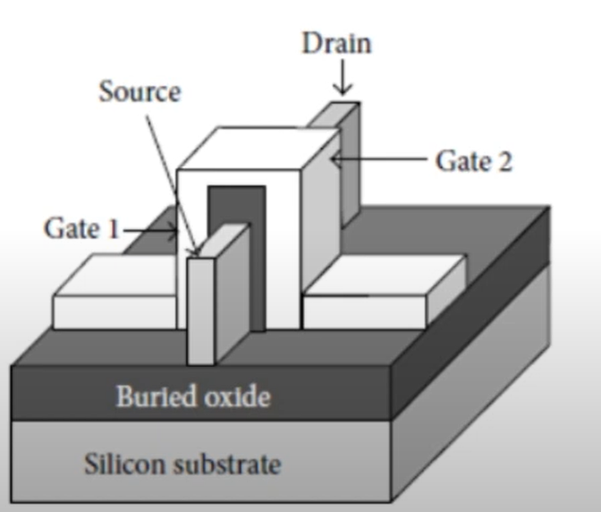
SOI Finfet
Isolation between adjacent devices.
Fabrication is costly as takes more steps in the process of fabrication.
Device isolation is not must.

Slide 18
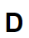
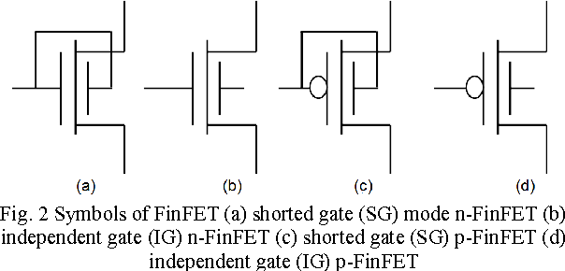
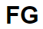
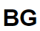
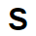

SYMBOL
D
FG
BG
S

Slide 19
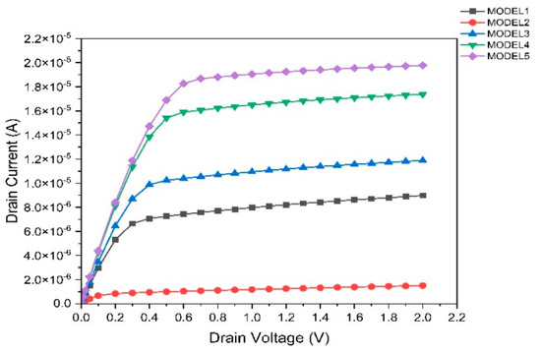
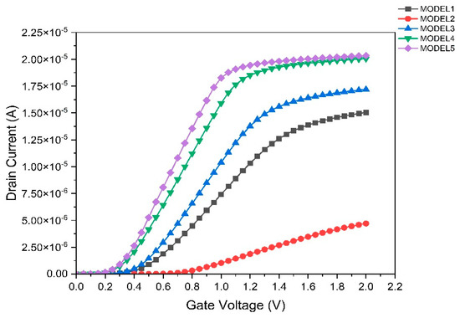
Output and Transfer Characteristics of FinFET
Output Characteristics
Transfer Characteristics

Slide 20
Characteristics of FinFET
Regions
Cutoff Region
Linear Region
Saturation Region
Breakdown region
Devices
Switch (Cutoff-OFF | Deep saturation-ON)
Voltage variable resistor (Linear Region)
Amplifier (Saturation region)
Voltage variable capacitance
Constant current source
Voltage controlled current source

Slide 21
Pros and Cons
Pros
Cons
Higher gate control
Low power consumption
Short-Channel effects are reduced
Higher driving Voltage
Greater speeds of operation
Occupies less area
Compex to model and fabricate
Removal of parasitic elements is complex
Needs high aspect ratio
Quantized device-width.
High fabrication cost.
Very high capacitances

Slide 22
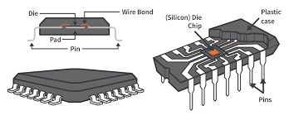
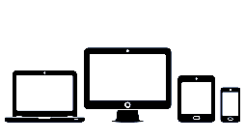
Applications
Load Switches in Micromechatronics
Making of ICs
Home computers
Laptops
Tablets
Smartphones
Wearables.

